Slide 1
Beliefs, spirituality and HIV: Overcoming barriers and harnessing benefits
Women for Positive Action is an educational programme funded and initiated by AbbVie
Notes:
The slides overview the area of beliefs, spirituality and religion in women living with HIV and are intended for use by both faith leaders and healthcare professionals
This slide presentation has been produced as part of the Women for Positive Action initiative. Women for Positive Action aims to empower, educate and support women with HIV and the healthcare professionals who treat them
This Women for Positive Action educational slide kit is intended for use by community representatives and those living with HIV who want to create or participate in learning opportunities relating to improving the care of women living with HIV. While the deck can be used in its entirety, it may be more suitable to select appropriate slides based on each individual educational opportunity
If you have any questions about Women For Positive Action, please email the Women for Positive Action secretariat: wfpa@litmus-mme.com.
This kit contains a PowerPoint presentation for use in any non-commercial setting. These files are provided by the Women for Positive Action initiative. By requesting these materials, you are agreeing to use them as provided. However, if you choose to significantly adapt or edit these slides, change the meaning or context of the information, or use them for a purpose other than that outlined above, you accept responsibility for the content of your presentation and agree to use a different slide template
Accuracy of information and disclaimer
We do our best to ensure that all information and material on the slides is accurate as of August 2016; if you find anything that is inaccurate please inform us and we will correct it as soon as practicable
We provide use of these resources free of charge and do so on the basis that we have no liability for their use
Women for Positive Action is an educational programme funded and initiated by AbbVie

Slide 2
Contents
Introduction
When beliefs, faith, spirituality and religion can be a barrier to managing HIV
What beliefs, faith, spirituality and religion can offer women with HIV
Engaging with faith leaders and faith-based organisations
Case studies

Slide 3
Introduction
Women for Positive Action is an educational programme funded and initiated by AbbVie

Slide 4
What do we mean by spirituality, faith, religion and beliefs?
Spirituality ‘human experience that seeks to transcend self and find meaning and purpose through connection with others, nature and/or a Supreme Being. Spirituality may or may not involve religious structures or traditions’ ¹
Faith ‘a trusting belief in a Supreme Being and/or said being’s role in the control of spiritual things’ ²
Buck et al. 2006; Pulchalski & Buck 2010.
Notes:
Spirituality is a personal experience, driven by the individual’s inner being and can be broadly defined as that which gives meaning and purpose to life.^{1–3} Women living with HIV have described the benefits of spirituality as providing peace, happiness and stress reduction. Spiritual practices include:
Prayer
Service attendance
Reading spiritual literature
Developing daily spiritual rituals
The core components of spirituality have been described as:
Connection with self
Connection between individuals (e.g. friendship and trust)
Connection with transcendence (e.g. mystery and mystical experiences; transpersonal connections beyond current life)⁴
Spirituality/religion is a complex notion that can include a combination of the following:
Internal and personal expression (assessed by spiritual wellbeing, peace and comfort derived from faith, or spiritual coping)
Formal, institutional and outward expression (assessed by the importance of religion, belief in God, and frequency of attendance at religious services or prayer)⁵
References:
Buck HG. Spirituality: concept analysis and model development. Holist Nurs Pract. 2006;20:288–292.
Puchalski C & Ferrell B. Making health care whole: Integrating spirituality into patient care. 2010. Templeton Press.
Cotton S, et al. Spirituality and religion in patients with HIV/AIDS. J Gen Intern Med. 2006;21:S5–13.
Peltzer J & Hobbs Leenerts M. Spirituality as a component of holistic self-care practices in human immunodeficiency virus-positive women with histories of abuse. Holist Nurs Pract. 2007;21:105–112.
Reed PG. An emerging paradigm for the investigation of spirituality in nursing. Res Nurs Health. 1992;15:349–357.

Slide 5
What do we mean by spirituality, faith, religion and beliefs?
Religion ‘an organised approach to human spirituality which usually encompasses a set of narratives, symbols, beliefs and practices. These often have a supernatural or transcendent quality, that give meaning to the practitioner’s experiences of life through reference to a higher power or ultimate truth’¹
Beliefs ‘the psychological state in which an individual holds a proposition or premise to be true’²
1. Verhagen et al. 2006; 2. Ritter & Lampkin 2010.
Notes:
Beliefs, faith, spirituality are not restricted to traditional or organised religions, they:
May (or may not) involve belief in a ‘higher power’ or ‘superior being’
Can encompass a wide variety of practices and coping systems, including prayer, meditation, reflection and positive thinking
May be linked to communities, or can be unique to an individual; religion in itself can be a way of life
Can represent ‘teachings’ or a connection to a community, culture or ancestry
Often influence people’s understanding of concepts, such as health, illness, healing, curing
Spirituality can also be defined as the search for ones connection to the sacred.³ On the other hand, religion focuses on more prescribed beliefs, practices, rituals, and social institutional factors. The type of belief inherent to spirituality is different from that of religiosity, which refers to an individual’s beliefs and behaviours associated with a specific religious tradition
Religion is defined by boundaries while spirituality transcends personal, scientific and physical boundaries
References:
Verhagen PJ, et al. Religion and Psychiatry: Beyond Boundaries. 2009. Wiley-Blackwell.
Ritter LA & Lampkin SM. Community Mental Health. 2011. Jones and Bartlett Publishers.
Kremer H, et al. The fork in the road: HIV as a potential positive turning point and the role of spirituality. AIDS Care. 2009;21:368–377.

Slide 6
Why is spirituality, faith or religion important for women living with HIV?
Living with HIV can lead people to question the meaning of life, to seek guidance and a new life purpose
People living with HIV often describe their diagnosis as a ‘catalyst’ or positive turning point in their lives – spirituality can be a positive component of the HIV journey
Many people living with HIV turn to some type of belief or coping system for additional support, be it spirituality, religious faith, community groups or faith-based organisations
Ironson et al. 2006; Kremer et al. 2009.
Notes:
Spiritual as well as physical and emotional aspects should be considered when addressing the psychosocial needs of people living with HIV¹
A diagnosis of HIV may be a time when people re-examine their relationship with the ‘sacred’ or turn to their God²
Spirituality can enhance a person’s ability to cope with negative life events, and similarly negative life events can cause enhanced spirituality³
It is thought that this increase in spirituality might be related to a positive increase in actual health outcome through its role as a support system
References:
Koenig HG, ET AL. Handbook of Religion and Health. 2000. Oxford University Press: 7–14.
Kirkpatrick LA. Attachment, evolution and the psychology of religion. 2005. Guilford Press.
Braxton ND, et al. The role of spirituality in sustaining the psychological well-being of HIV-positive black women. Women Health. 2007;46;113–129.
Ironson G, et al. An increase in religiousness/spirituality occurs after HIV diagnosis and predicts slower disease progression over 4 years in people in HIV. J Gen Intern Med. 2006;21:S62–68.
Kremer H, et al. The fork in the road: HIV as a potential positive turning point and the role of spirituality. AIDS Care. 2009;21:368–377.

Slide 7
Challenges often experienced by women living with HIV
Parenting, pregnancy, children, carer responsibilities
Relationships, independence, violence
Quality of life
Coping, adjustment, responding to treatment
Diagnosis-related trauma
Women often experience challenges
Stigma-related stresses, fear, secrecy
Stresses related to telling others
Depression, suicidal thoughts/acts, emotional stress
Ageing and the menopause in HIV
Grief, loss and guilt
Risk behaviours
Body shape changes
Keegan et al. 2005.
Notes:
From the point of diagnosis, throughout their disease journey, women living with HIV face emotional stress-related burdens and uncertainties
Understanding how and where to access the support necessary to deal with these challenges is a key part of living with HIV
Reference
Keegan A, et al. Sex and relationships for HIV-positive women since HAART: A qualitative study. AIDS Patient Care STDs. 2005;19:645–654.

Slide 8
Where can women living with HIV seek support?
Doctors and other medical professionals
Peer support from other women with HIV
Friends and wider social circle
Sources of support for women living with HIV
Family, e.g. a sister
Community
Workplace (as an employer/ employee)
Faith-based organisations; places of worship
Internally through spirituality
Notes:
Some people believe there is an unhelpful conflict between beliefs/spirituality and the provision of modern Western medicine
However, there is a diversity of faith-based organisations in different countries, that may act as facilitators or gatekeepers to healthcare services
Doctors and women living with HIV should appreciate that beliefs, faith, spirituality and religion, can be used as both a barrier and a motivator in the management of HIV

Slide 9
Spiritual changes following HIV diagnosis
Intensification of spirituality
71%
53%
An increase in spiritual practices
A change in priorities and the awareness that time is of the essence
50%
Finding meaning and purpose in life
45%
37%
More gratitude and appreciation, feeling blessed
39%
Taking better care of own health
47%
Kremer et al. 2009.
Notes:
The diagnosis of HIV is seen by many people as a positive turning point in their lives and may encourage a positive transformation and finding new meaning in life
A survey conducted by Kremer 2009 reported the Top 10 positive changes due to HIV¹
Reference:
Kremer H, et al. The fork in the road: HIV as a potential positive turning point and the role of spirituality. AIDS Care. 2009;21:368–377.

Slide 10
When beliefs, faith, spirituality and religion can be a barrier to managing HIV
Women for Positive Action is an educational programme funded and initiated by AbbVie

Slide 11
Faith and beliefs as a barrier in HIV prevention
Religious teachings are sometimes used as justification for lack of sex education and abstinence-only advice
Beliefs such as ‘God will protect me’ and ‘God intended this for me’ may encourage
Risk-taking behaviour
Feelings of helplessness
Resignation
Denial
Inability to engage in healthy relationships
11
11

Slide 12
Potentially negative impact of faith-based institutions/traditions on women living with HIV
There may be a negative impact on women living with HIV if faith-based institutions, religious teachings, traditions and faith communities…
…claim religion or tradition as a justification for HIV as ‘a punishment’
…influence people to form negative opinions about their medication
...offer solutions, but with ‘strings attached’ to vulnerable women
12
Maman et al. 2009.
12
12
Notes:
There may be a negative impact on women living with HIV if faith-based institutions, religious teachings, traditions, and faith communities:
Claim religion or tradition as a justification for having HIV as ‘a punishment’
Religion can be used as a moral justification for contracting HIV. This can have a negative impact on people living with HIV leading to feelings such as ‘I deserve my disease’
For example, there are faith leaders/traditional belief systems that state HIV is attributed to dissatisfied ancestors, or moral misconduct
Offer solutions, but with ‘strings attached’ to women living with HIV
Some women living with HIV may be vulnerable to ‘recruitment’ from organisations that appear to offer solutions, but with ‘strings attached’
For example, the Church may accept the individual on the basis that they must tell others about their HIV in order to become part of the congregation
Influence people to form negative opinions about their medication
Faith and belief may represent a barrier to testing and treatment through the resignation that one’s status is ‘god’s will’ and human action would make no difference
Furthermore, religious belief can be a barrier to treatment and care as some women may put their faith in God, believing that He will cure and provide
Reference:
Maman S, et al. The role of religion in HIV-Positive women’s disclosure experiences and coping strategies in Kinshasa Democratic republic of Congo. Soc Sci Med. 2009;68:965–970.

Slide 13
Stigma, shame and guilt
Stigma: ‘attribute of an individual that is undesirable or discrediting in the eyes of society, thus reducing that individual’s status’
HIV stigma exists, including in some faith communities where HIV is considered a ‘punishment from God’
Feelings of guilt can stem from some religious teachings
Religion may play a role in both:
Causing HIV stigma
Non-discrimination and acceptance of women living with HIV
Zou et al. 2009; Muturi & An. 2010.
13
13
Notes:
Stigma can be associated with religious beliefs and can instil or reinforce the attitude that people with HIV have not followed ‘the Word of God’ and, therefore, deserve their fate^{1,2}
Stigma can prevent some women living with HIV from telling others about their diagnosis, potentially due to fear of exclusion from their religious/cultural community, and can create a barrier to social support, which is often necessary for coping
References:
Zou J, et al. Religion and HIV in Tanzania: influence of religious beliefs on HIV stigma, disclosure, and treatment attitudes. BMC Public Health. 2009;9:75.
Muturi N & An S. HIV/AIDS stigma and religiosity among African American women. J Health Comm. 2010;15:388–401.

Slide 14
What beliefs, faith, spirituality and religion can offer women living with HIV
Women for Positive Action is an educational programme funded and initiated by AbbVie

Slide 15
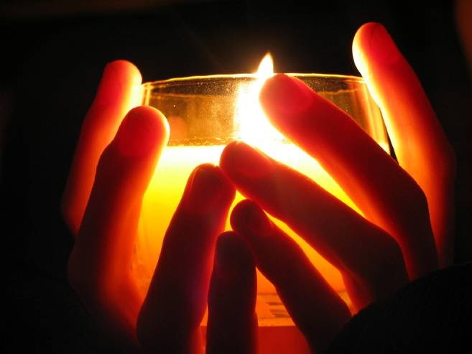
Prayer as an ‘absent counsellor’
The roles played out by prayer in wellbeing include:
Acting as an absent counsellor
Construction of a compassionate ‘life scheme’
Interruption of negative rumination
Promoting mindfulness
Promoting positive thinking
Achieving results
15
Ridge et al. 2008.
15
15
Notes:
A study showed that 92% of women believe that prayer is important in HIV decision making
Advantages of an absent counsellor over speaking with another person include:
Handing over control of uncontrollable situations
Reduced anxiety through constructing a life narrative that includes being protected by a higher power and having a sense of purpose
Prayer is related to the church and may take the role of an absent counsellor while meditation is non-organised
Prayer is a form of meditation, which means reflecting on ones own inner resources, reaching inwards, self-awareness
Reference:
Ridge D, et al. Like a prayer: the role of spirituality and religion for people living with HIV in the UK. Sociol Health Illn. 2008;30:413–428.

Slide 16
The beneficial effects of prayer
Prayer can be an important buffer against stress
Women often use prayer to overcome the initial shock, sadness and anger of hearing their HIV diagnosis
Many find prayer an effective self-care strategy
Women rely more on prayer and religion than men in dealing with health-related issues
Crane et al. 2000.
Notes:
In a survey of women living with HIV, 92% of women reported that prayer was important in HIV medication decision making, while 88% reported that prayer was important in all aspects of life.¹ Few women mentioned the use of formal prayers or attendance at religious services. Instead, prayer was considered as a means of addressing God and asking for God’s guidance and intercession¹
People living with HIV believe that they can get additional benefits from prayer compared with speaking to another person²
Women rely more on prayer and religion in dealing with health-related issues and prayer is an important buffer against stress. The majority found it an efficacious self-care strategy³
References:
Crane JR, et al. Women with HIV: Conflicts and synergy of prayer within the realm of medical care. AIDS Ed Prevent. 2000;12:532–543.
Ridge D, et al. Like a prayer: the role of spirituality and religion for people living with HIV in the UK. Sociol Health Illn. 2008;30:413–428.
Coleman CL, et al. Gender differences in the use of prayer as a self care strategy for managing symptoms in African Americans living with HIV/AIDS. J Assoc Nurses AIDS Care. 2006;17:16–23.

Slide 17
Prayer and decisions about HIV medication
If I pray, God will give me the right medication and the right people to direct me through this HIV
I go by what the doctor advises…take it home and pray about it and do what God wants me to do
Prayer is the first thing, but you also need support of doctors to push you and make you understand
My doctor wanted me to go on medication and I told her that I have to think about it, but I just pray about it….I was scared, but I prayed to God for the wisdom and knowledge
The doctor guides your body and whatever reactions are going on in your body…. But prayer guides your soul, and that’s where you need your inner peace and your strength
Crane et al. 2000.
Notes:
Some women living with HIV have suggested that prayer is essential to their lives, to coping with their HIV diagnosis and to making decisions about HIV medication. Prayer is classed as a means of obtaining support and clarity for decisions related to HIV medication
Overall, the women surveyed in this research were inclined to use prayer in combination with their clinician’s advice, i.e. to combine extrinsic (physician, family, information material) and intrinsic (prayer, beliefs and attitudes) resources in their decision-making process
Reference:
Crane JR, et al. Women with HIV: Conflicts and synergy of prayer within the realm of medical care. AIDS Educ Prev. 2000;12:532–543.

Slide 18
Spirituality can provide support
Spirituality can help women living with HIV to ‘move on’
“Why, when, how was I infected?”
“How can I live my life with HIV?”
Someone out there is ‘on my side’
Comfort and support of a ‘greater good’
A meaning to life
1. Crane et al. 2000; 2. Ridge et al. 2008.
Notes:
References:
Crane JR, et al. Women with HIV: Conflicts and synergy of prayer within the realm of medical care. AIDS Ed and Prevent. 2000;12:532–543.
Ridge D, et al. Like a prayer: the role of spirituality and religion for people living with HIV in the UK. Sociol Health Illn. 2008;30:413–428.

Slide 19
Positive impact of faith and spirituality
Finding a ‘meaning’
Comfort
Coping
Calmness
Move into a positive mindset
Happiness
Empowerment
Support
Mindfulness
Feeling of ownership over the future
Strength to reach out to others
Notes:
There are a variety of ways religion/spirituality can positively impact women living with HIV
A comforting belief system may be related to slower disease progression through positive psychological effects, including improved optimism and reduced depression¹
Some women believe that the influence of belief in a God enhances their ability to cope with their HIV diagnosis. The benefits of an active spiritual life may include peace, happiness and stress reduction²
Mindfulness is associated with greater calmness and clarity of thought. It relates to living in the present moment, and is related to a variety of potential benefits for subjective and real-world experiences, including:
Interruption of negative rumination (the continuous replaying in ones head of personal stories that may contribute to negative mood states)
Taking greater responsibility for your own life decisions
Doing things that are beneficial for the future
Making choices to better look after yourself
A greater enjoyment of life³
References:
Ironson G, et al. An increase in religiousness/spirituality occurs after HIV diagnosis and predicts slower disease progression over 4 years in people with HIV. J Gen Intern Med. 2006;21:S62–68.
Woodard EK & Sowell R. God in control: women’s perspectives on managing HIV infection. Clin Nurs Res. 2001;10:233–250.
Ridge D, et al. Like a prayer: the role of spirituality and religion for people living with HIV in the UK. Sociol Health Illn. 2008;30:413–428.

Slide 20
Spirituality is linked to positive themes
Connection to God, Higher Power or Spirit
Growing closer to God
Religion and church/ church attendance
Reason or purpose; second chance
Spiritual support
Faith/belief in God
Health and healing
Prayer, helping others, being thankful, testifying to others
Inner peace, strength, ability to ‘keep going’
1. Dalmida et al. 2012.
Notes:
Reference:
Dalmida SG, et al. The Meaning and Use of Spirituality Among African American Women Living With HIV/AIDS. West J Nurs Res. 2012;34:736–765.

Slide 21
Spirituality and clinical outcomes
Higher spiritual wellbeing impacts on emotional aspects of HIV and may lead to:
Reduced emotional distress
Lower rate of depression
Greater optimism
Better psychological adaptation
Greater preservation of CD4 cells
Better control of viral load
Maman et al. 2009.
Notes:
A growing body of evidence suggests beneficial effects of spirituality on physical and mental health
Reference:
Maman S, et al. The role of religion in HIV-positive women’s disclosure experiences and coping strategies in Kinshasa, Democratic Republic of Congo. Soc Sci Med. 2009;68:965–970.

Slide 22
HIV therapy impacts on the mind and body
Mind
Potential benefits of antiretroviral therapy on mental and emotional wellbeing
Body
Potential beneficial effects of antiretroviral therapy on physical wellbeing and visible symptoms of HIV
Ickovics et al. 2009.
Notes:
HIV therapy can lead to physical and mental/emotional changes in the individual living with HIV
Women living with HIV are particularly vulnerable to experiencing depressive symptoms and depression is more prevalent in HIV-infected women compared with men¹
Reference:
Ickovics JR, et al. Mortality, CD4 cell count decline, and depressive symptoms among HIV-seropositive women. JAMA. 2001;285:1466–1474.

Slide 23
Effect of spirituality on adherence
Spiritual/mind–body beliefs are related to treatment decision-making and adherence in people living with HIV
Can act as both barriers and motivators
Mind-body beliefs may result in enhanced adherence
Those believing that health is controlled by a ‘higher power’ were more likely to refuse antiretroviral therapy
Kremer et al. 2009.
Notes:
Barriers of spiritual/mind–body beliefs on treatment decision making
Those believing that God/‘higher power’ controls health were almost 5 times more likely to refuse antiretroviral therapy than individuals without those beliefs
Participants with mind–body beliefs related to decision making were 5 times more likely to defer treatment than those without those beliefs
Such perspectives may lead to the belief that even in an advanced disease stage, medication is not needed, which may be a harmful treatment choice
Motivators of spiritual/mind–body beliefs on treatment decision making
For those who decide to take treatment, mind–body beliefs may promote better adherence
Mind–body beliefs may encourage individuals to postpone antiretroviral therapy until they are ready to take them and, therefore, enhance adherence once the individual is prepared to take treatment
It is important to discuss faith and beliefs with healthcare professionals to find the best way forward with HIV management
Reference:
Kremer H, et al. Spiritual and mind–body beliefs as barriers and motivators to HIV-treatment decision-making and medication adherence? A qualitative study. AIDS Patient Care STDs. 2009;23:127–134.

Slide 24
Mindfulness and meditation in HIV
Mindfulness-Based Stress Reduction uses mindfulness and meditation techniques to reduce and alleviate stress¹
Considered useful in the management of chronic conditions¹
May help reduce any potential stress linked with HIV treatment-related side effects
Ask your doctor for details on how you can find out more about these techniques
Niazi & Niaki. 2011.
Notes:
Reference:
Niazi AK & Niaki SK. Mindfulness-based stress reduction: a non-pharmacological approach for chronic illnesses. N AM J Med Sci. 2011;3:20–23.

Slide 25
Engaging with faith leaders and faith-based organisations
Women for Positive Action is an educational programme funded and initiated by AbbVie

Slide 26
Benefits of engaging with faith leaders
There are many organisations that take a faith-based approach to HIV
Many of these have projects and resources aimed to educate faith leaders and to help them:
Support members of their congregation living with HIV
Educate the community and therefore reduce stigma against people living with HIV
Elicit meaningful discussions during services
Encourage openness among their congregation

Slide 27
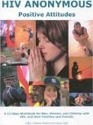
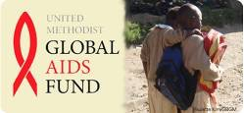
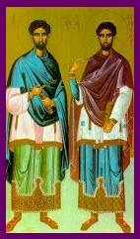
HIV and religion/belief initiatives
Women for Positive Action is supported by a grant from Abbott
Notes:
All websites listed below are available in English, other languages are listed in brackets.
Examples of HIV and religion/beliefs initiatives:
African Health Policy Network – UK; international reach
Healing Begins Here – US; California and some national schemes
AIDS Alliance for Faith and Health – US
Stop AIDS now! – The Netherlands (English, Spanish, French, Portuguese, Dutch); global
Christian Aid – UK; global reach
The Balm in Gilead – US; national and Africa
Presbyterian AIDS Network – US; regional and international reach
National Episcopal AIDS Coalition – US; national reach
NAZ Project London – UK; London
HIV anonymous – UK; London
Caritas – Vatican City (English, French, Spanish); global reach
Caritas – Germany
Tearfund – UK; global reach
Ecuminical Advocacy Alliance – Switzerland (English, French, Spanish, German); international reach
Keep the promise HIV and AIDS campaign – Switzerland (English, French, Spanish, German, Portuguese, Russian); international reach
International Network of Religious Leaders Living with and Personally Affected HIV and AIDS – South Africa; global reach
Strategies for Hope Trust – (English, French); global reach
Diakonie – Germany (English, German); national reach
The United Methodist Committee on Relief (UMCOR) – US; global reach
United Methodist global AIDS fund – US; global reach
AIDS Ministry of the Greek Orthodox Metropolis of San Francisco – US; national reach
World Conference of Religions for Peace – UK; global reach
International Center for Research on Women – US; global reach
Islamic Relief Worldwide – UK (partner sites for each country in native language: German, Turkish, Arabic, Dutch, Swiss, French, Italian, Swedish etc.); global reach
Canadian AIDS Society – Canada (English, French); national reach
The Canadian Council of Churches – Canada (English, French); national reach
The Presbyterian Church in Canada – Canada; national reach
The United Church of Canada – Canada (English, French); national/international reach

Slide 28
Links to support resources*
African Health Policy Network
Healing Begins Here
AIDS Alliance for Faith and Health
Stop AIDS now!
Christian Aid
Presbyterian AIDS Network
National Episcopal AIDS Coalition
NAZ Project London
Caritas
Tearfund
Ecuminical Advocacy Alliance
The Balm in Gilead
Strategies for Hope Trust
Keep the promise HIV and AIDS campaign
Catholics for AIDS prevention and support
International Network of Religious Leaders Living with and Personally Affected HIV and AIDS (INERELA+)
United Methodist global AIDS fund
World Conference of Religions for Peace
International Center for Research on Women
Islamic Relief Worldwide
Canadian AIDS Society
The Canadian Council of Churches
The Presbyterian Church in Canada
The United Church of Canada
Diakonie
*Please view this presentation in slide show mode to access the hyperlinks

Slide 29
Catholics for AIDS Prevention and Support (CAPS)
A network of Catholics in Britain and Ireland promoting HIV prevention and support
Objectives
To promote education and prevention, treatment, care and relevant pastoral ministry for those living with and affected by HIV/AIDS
To promote the practical, financial, emotional, spiritual, sacramental and pastoral needs of people living with or affected by HIV/AIDS and to develop appropriate responses
To promote continuing reflection on all aspects of ethical, theological, and other challenges raised by HIV/AIDs, not least issues of social justice, through publication, seminars, and other relevant means
29

Slide 30
Catholics for AIDS Prevention and Support (CAPS)
Resources available on the website include:
A film: ‘Love tenderly act justly: Stories of HIV and Christianity’
Includes interviews from Rev. Byamugisha and Angelina Namiba
Posters and leaflets to support local CAPS groups
Recommendations for further reading
Articles in relation to positive Catholics and HIV:
A Gift Weaved from Thorns: HIV as Gift and Challenge in the Church
Positive Catholics: The Universe
Julian of Norwich and a Pastoral Approach to HIV
The Joy of the Gospel and CAPS Ministry: Catholic Times February 2014
30

Slide 31
African Health Policy Network (AHPN)
An alliance of African community-based organisations and their supporters
The AHPN’s mission is to improve the health and wellbeing of Africans living in the UK who are disproportionately affected by long-term health conditions such as HIV, mental health, diabetes and obesity
The APHN aims to narrow the health inequality gap by ensuring that African communities in the UK have equal access to services, support and information
31
Notes:
Examples of AHPN activities include:
HIV and Faith Discussion Paper. Engaging Muslim and Christian leaders on the issue of HIV (2009)
Faith leaders toolkit: Breaking the Loud Silence of HIV (see next slide)
Multi-language HIV prevention DVD
Campaign on widespread global access and use of microbicides
The ‘Vital Voices’ leadership programme
Working with faith communities to challenge stigma and HIV
Directory of faith organisations who support work around HIV
A pilot training course for clergy members in an area of London designed to provide clergy members with a strong background on HIV

Slide 32
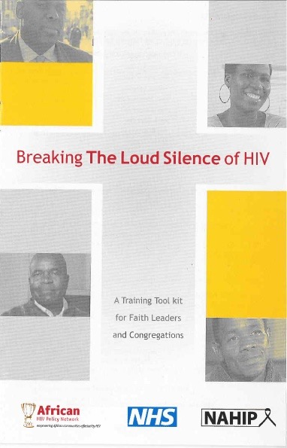
AHPN: ‘Breaking the Loud Silence of HIV’
Part of the AHPN ‘Changing perspectives’ campaign
Toolkit (DVD and manual) for Christian faith leaders to use during services and workshops
Includes contributions from a vast network of people living with HIV, including faith leaders and other individuals willing to speak openly about their status
Designed to encourage discussion about various aspects of HIV including stigma, testing, transmission, support and living positively
Notes:
‘Breaking the Loud Silence of HIV’ is a toolkit available to faith leaders who attend an associated training course
This toolkit aims to train faith communities on HIV and the stigma surrounding the disease. It describes how faith-based organisations can be supportive of the congregation and is designed for use at prayer meetings, bible class or as part of a Church education programme
‘Breaking the Loud Silence of HIV’ is provided by UK National African HIV Prevention Programme (NAHIP) and the African Health Policy Network (AHPN)
‘Breaking the Loud Silence of HIV’ content:
Living with HIV
Testing and transmission
Support from churches
Helping faith leaders and congregations
Living positively
Using the tool kit
Inspirations

Slide 33
AHPN: Faith Positive
Faith Positive champions visit places of worship to start conversations about HIV stigma and discrimination
By staging presentations and monologues to African congregations, Faith Positive champions challenge negative perceptions about people living with HIV
Workshops, seminars and focus groups are provided as well as presentations during Sunday morning worship
Faith Positive champions offer a ‘buddying’ programme for church congregations, providing peer support for new testers and those newly diagnosed
www.ahpn.org.uk/faithpositive.php.
Notes:
Along with giving information about HIV testing and diagnosis. Faith Positive also runs rapid HIV testing events to encourage HIV testing and early diagnosis within the African community

Slide 34
AHPN: Faith and wellbeing mental health project
AHPN works simultaneously with faith leaders from black-led churches and members of the African and Caribbean communities who are living with mental health problems
Faith in Wellbeing Project (FWP) leads are trained in communication and drama, to take their personal stories into black-led churches, faith and fellowship groups
This project aims to:
Improve public attitudes and behaviour towards mental health issues, which will lead to people facing less discrimination
Improve the confidence and ability for dealing with mental health problems and to take action to tackle stigma and discrimination
Improve the confidence of people with mental health problems to engage in and contribute to the life of their community
www.ahpn.org.uk/faithpositive.php.

Slide 35
Faith-based organisations: An important source of information for faith leaders
Caritas (Catholic Church)
Takes a holistic approach to the disease, focusing on the physical, intellectual and spiritual needs of the person
Caritas International is lobbying for child-friendly HIV and AIDS medicines
Presbyterian AIDS Network
Welcomes those who advocate and care for people and families who have been infected or affected by HIV/AIDS
Encourage the Church to live out Jesus’ ministry of love and justice
35

Slide 36
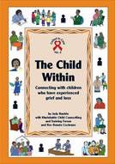
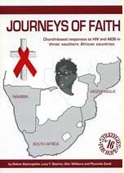
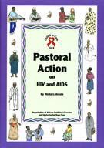
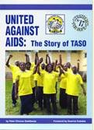
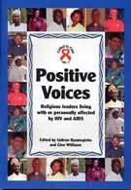
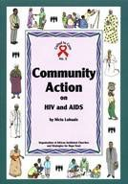
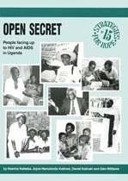
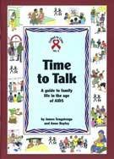
Strategies For Hope Trust (SFHT)
A UK charity that works in collaboration with many organisations in Africa, Asia, Europe, North America and the Caribbean to promote positive thinking and practical action in the field of HIV/AIDS care, support and prevention, particularly in sub-Saharan Africa
Free study books focusing on aspects of HIV in Africa/Asia
‘Called to Care’ booklets for church leaders
36

Slide 37
Tearfund
Tearfund is a leading relief and development charity, working in partnership with Christian agencies and churches worldwide
Tearfund tool for faith leaders: ‘Right Here Right Now: How Your Church Can Take Action to Help People Living with HIV’
Provides practical steps to help churches address issues faced by people living with HIV in their community
Guidance on how to lead a prayer meeting/service
Notes:
Tearfund has a strategy to tackle HIV at international, national and local levels. This plan includes:
Preventing mother-to-child transmission of HIV
Supporting women and children affected by HIV
Promoting access to treatment, including anti-retroviral drugs
Ending stigma and discrimination
Changing behaviour among young children and adults
‘Right Here Right Now: How Your Church Can Take Action to Help People Living with HIV’ is a manual for faith leaders
Provides practical steps to help churches address issues faced by people living with HIV in their community, for example:
Befriending schemes
Translation and support in accessing testing and treatment
Welcoming people with HIV into communities
Spiritual guidance
Education in schools
Information on how to lead a prayer meeting/service to:
Inform the congregation about HIV and dispel myths
Discuss stigma
Involve people living openly with HIV to share their stories
Highlight each individual person’s contribution to the community to foster a spirit of cooperation

Slide 38
Christian Aid
Christian Aid is a leading British and Irish organisation, their work is founded on the Christian faith
Christian Aid provides community-based care and support by working with local grassroots organisations to:
Prevent HIV transmission
Overcome the stigma and discrimination attached to HIV
Notes:
Christian Aid has 148 partners working in 40 different countries
Examples of Christian Aid activities include:
Work with leaders of all faiths to challenge the stigma associated with HIV
Work with faith leaders to promote HIV prevention and defend the human rights of those living with HIV

Slide 39
Christian Aid
Christian Aid has moved away from the previous ‘ABC’ approach to prevention: Abstinence, Be faithful, Condom use
Now provides holistic prevention of HIV through the more comprehensive ‘SAVE’ approach, developed by their partner organisation, African Network of Religious Leaders (ANERELA+):
Safer practices
Available medication
Voluntary counselling and testing
Empowerment
SAVE incorporates key elements of ABC, but also:
Provides information on non-sexual modes of transmission, testing, care and support
Diminishes misconceptions that HIV is only sexually transmitted
Decreases the stigma and discrimination surrounding HIV
Recognises that ‘HIV is a virus…not a moral issue’

Slide 40
YOUR Blessed Health (YBH)
A HIV-prevention intervention designed to increase the capacity of faith based organisations to address HIV/AIDS among African Americans aged 11–19 years
Aim: To change the norms of churches to be more open and accepting to settings where young people and adults can discuss HIV/AIDS and risky behaviours
The pilot of YBH has illustrated that faith-based HIV-prevention programmes are feasible and well-received if they follow some basic principles
Respect the denominational doctrines and visions of the pastors
Engage pastors’ spouses (or some other group) as champions
Build on Church leadership teams’ understanding of what is appropriate and acceptable
Griffith D et al. 2010.
Notes:
YOUR Blessed Health (YBH) provides faith-based organisations with a flexible menu of options from which faith leaders can adapt the intervention to the beliefs, doctrine and culture of their individual organisations.
YBH is unique in that it seeks not only to educate young people, but also to train adult faith leaders
Particularly pastors’ spouses, to address HIV/AIDS and youth sexual risk using a curriculum endorsed by the National Coalition of Pastors’ Spouses
The YBH intervention includes five basic components:
A 10-hour, five-session youth training programme using the HIV Outreach, Prevention, and Education (HOPE) curriculum, which focuses on the basics of HIV/AIDS, sexually transmitted infections, sexual knowledge, communication skills, and helping young people to create individualised risk-reduction plans
A 10-hour, five-session training programme for adults in the Church and community based on the HOPE curriculum, which provides basic STI and HIV/AIDS knowledge
Ongoing training and support for pastors, pastors’ spouses, and other Church leaders who will conduct the youth and adult training sessions, which provide them with the basic knowledge, skills and resources to lead the YBH sessions and conduct other church HIV/AIDS educational activities
Church-wide activities, including sermons and presentations during the primary weekly service to raise awareness of HIV/AIDS and HIV risk, and to reduce stigma associated with HIV/AIDS and people living with HIV/AIDS
Community-wide activities such as health fairs that educate and raise awareness about HIV/AIDS and promote collaboration among different faith-based institutions on HIV prevention

Slide 41
NAZ Project London: Testing Faith
Testing Faith is an HIV prevention programme designed especially for faith leaders supporting black and ethnic minority congregations
A dynamic, comprehensive programme to help faith leaders support their congregations’ sexual and social health needs, particularly around HIV prevention, treatment and care
Aim: To promote a better understanding of sexual health in BAME communities
www.testingfaith.org.

Slide 42
Case studies
Women for Positive Action is an educational programme funded and initiated by AbbVie

Slide 43
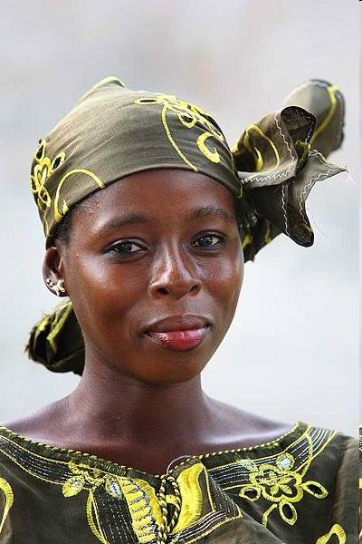
Case study: Culture, belief and faith in HIV – Christine’s story
Christine, a 35-year-old African woman living in Europe with her husband
Christine is HIV+, husband is HIV–
Christine became pregnant by self-insemination
Her child died before delivery
In her culture women are not allowed to grieve when a child is lost as it is believed that:
The dead child will come back while you are grieving
The next child may also die
How did Christine cope with her situation?

Slide 44
Case study: Culture, belief and faith in HIV – Christine’s story
Christine confided in her mother who reassured her that she should grieve like a European woman and nothing bad will happen
This advice encouraged her to join a group for bereaved parents, which has helped her cope with her loss and develop a more positive outlook on her future
How can Christine be supported with her grief?

Slide 45
The outcome of Christine's story
Christine wants to get pregnant again and is receiving counselling
Her main issue in counselling is her trust in God that the health of her next baby is in his hands
She must be supported not to mistrust her body, which she thought has failed her
She believes that God has given her the task to be responsible for her own health
Notes:
Humans are often illogical in both their deep-held beliefs and their behaviours
Education is often not enough to modify damaging or risky behaviour
Beliefs are, therefore, a reality and an integral part of care as they are fundamental to the way most people think and act in everyday life
Beliefs are important for many women living with HIV, wherever possible it is more effective for doctors to work ‘with’ beliefs, not ‘against’ them
It is crucial to integrate science, medicine and these beliefs, rather than attempting to fight against a woman’s belief system with ‘science’ or ‘logic’
Stories such as Christine’s can often be used to engage religious patients to accept their diagnosis or treatment

Slide 46
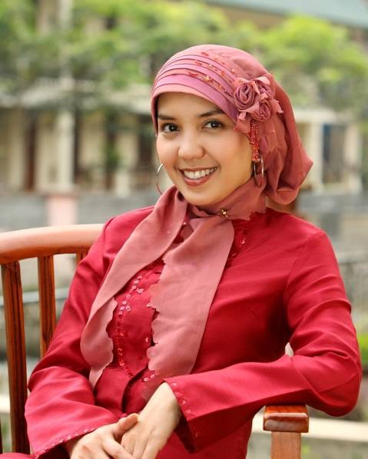
Case study: Fasting and religious beliefs in HIV – Sadiyah’s story
HIV+ Islamic woman approaching the Ramadan fasting period
Has told the religious community
Stops taking medication during fast times
Believes that God will take care of her

Slide 47
The outcome of Sadiyah’s story
Sadiyah’s physician learns about the lack of adherence
The need for medication adherence is discussed during her consultation
Sadiyah’s physician encourages her to approach her faith leader
Following discussions with her faith leader and physician the importance of medication adherence is recognised

Slide 48
Case study: Gender imbalance and religious beliefs in HIV
Woman aware of her HIV+ status and has told others within her
Family
Close religious community
Husband receives a positive diagnosis
Domestic violence as he ‘blames’ his wife for his diagnosis
How can the physician help the woman to recognise the importance of turning to religion for support?

